Slide 1
2013 TX Vehicle Crash
Case Study
Taraneh Moll

Slide 2
The problem
Lots of Information
Context
Problem statement
We have a large amount of data about car crashes in TX, but we don’t know what is important
By narrowing information down to a specific focus area- fatalities we can see if we can find a solution to help reduce deaths by car accidents.
We need to look at patterns in fatal car crashes

Slide 3
Challenges deep-dive
Challenge 1
Challenge 2
Challenge 3
Analyze the data from 2013 car crashes in Texas
Find facts and patterns that are easy to understand and solve
Develop a solution and implementation plan

Slide 4
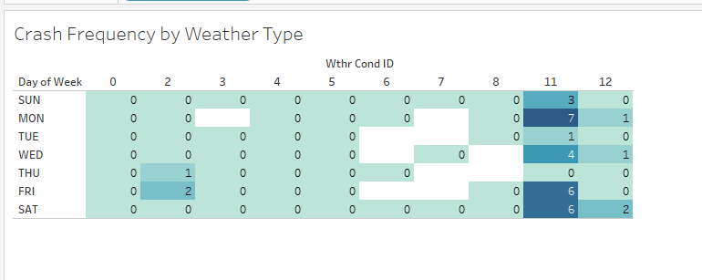
Weather Affects Frequency of Car Crashes

Slide 5
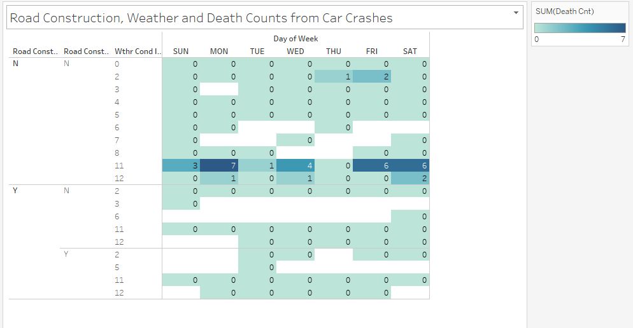
Road Construction Does Not Affect Death by Car Crashes

Slide 6
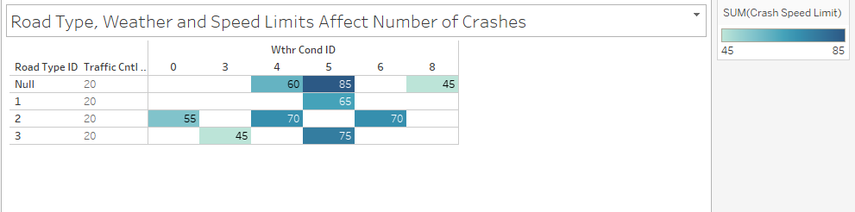
Speed Limit Increases Crash Incidences
Speed Limit of 85 had the most crashes

Slide 7
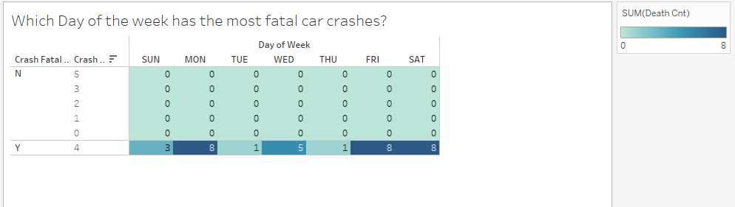
When do fatal car crashes occur most?
Mondays

Slide 8
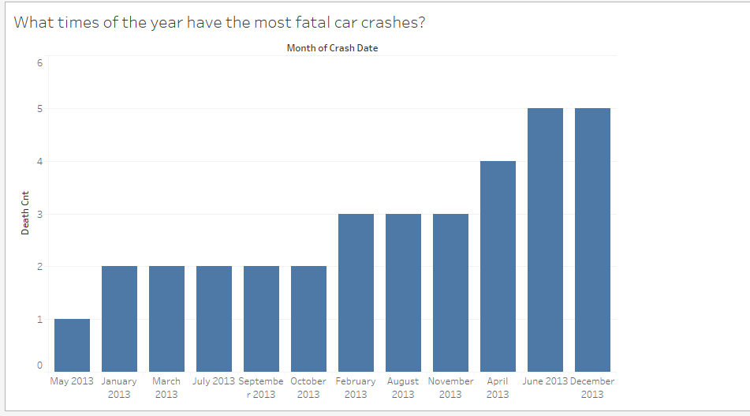
What times of year do fatal car crashes occur most?
June and December

Slide 9
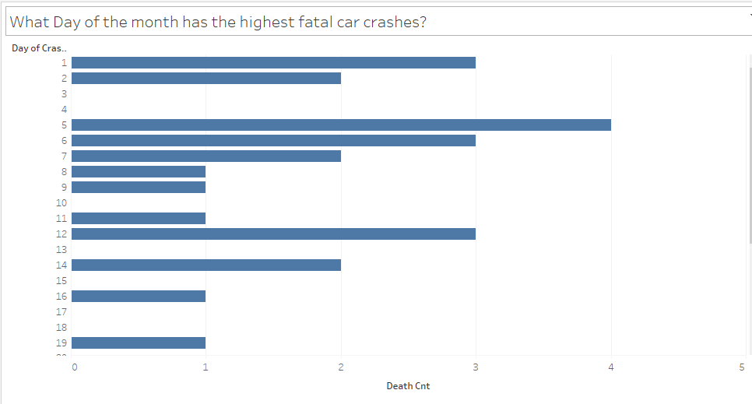
What day of the month has the highest fatalities?
5th of the month

Slide 10
Solution
Weather can’t be controlled, but speed limits can be reduced. By developing a marketing campaign to increase citizen awareness of the increased fatality rates on roads with speed limits of 85, there will be more understanding of the need to reduce speed limits to save lives.

Slide 11
Implementation
Lower Speed Limits
Reduce all 85 speed limit roadways to Speed limit 65
Enforce speed limits with increased highway patrol

Slide 12
Long Term Impact
Decrease in fatal accidents in TX

